Slide 1
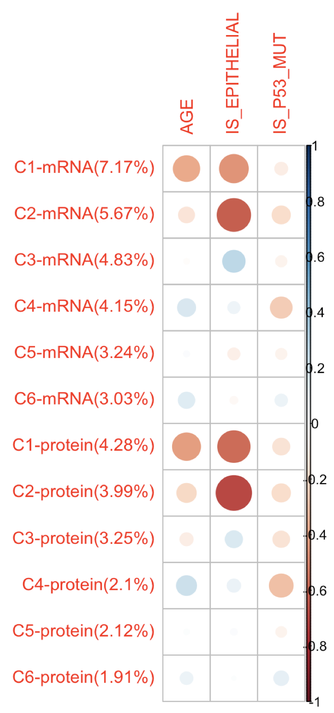
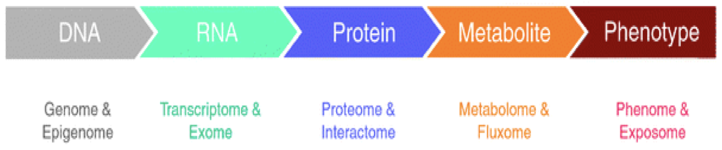
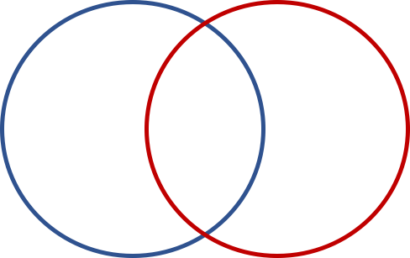
-Omics Data Integration with O2PLS
Orthogonal Omics 1
Orthogonal Omics 2
Joint
Notes:
I am going to present one of the omics integration methods that finds the statistical associations and correlations of data across omics layers and performs well on both low and high dimensions. It is called Two-way orthogonal paritial least square so called O2PLS.
As the technology improves, we could measure more and more variables, and these high dimensional data plays an important role in medical sciences. In the level of omics, like genomics, transcriptomics, proteomics, metabolomics, it is really important to understand the similar patterns between omics, and understand the relationships of one variable from one omics to the variables from the other omics datasets.
And, these combining omics for the analysis, helps us understand the function of genes and associations between metabolites and phenotypes, and at the same time, this complements missing or unreliable information from single omics analysis.
I can say that the beauty of O2PLS is fast working, can find the joint variables between two different omics, and it also gives the unique variables for each omics, and gives the noise variables as well.
So, to help you understanding what I said, maybe you can think of it as a double/muti PCA. I mean it is not exactly working the same way as PCA, PCA gives the loading and scores by capturing the highest variance of the data but its only working on the one dataset. But, O2PLS can work on the two datasets, finding the associations between those two, and spitting out the scores and loadings for each orthogonal parts and joint part as well.
So, scientists who are interested in finding the highly correlated gene expressions between two omics, O2PLS is the right one to use.
So, say that you found the genes that are highly significant on each joint score, and at the end of the day, you can also compare all those joint score from the two datasets with the sample meta-data, and calculate the univariate correlations, which can also help scientists understand the relationships between the specific genes and phenotypes.

